Slide 1
MASTER YOUR IMAGE Prepared by Janine E. Asmar fashion designer image consultant
Notes:
By Janine E. Asmar

Slide 2
What is image?
Why is image important?
HOW CAN IT AFFECT OUR LIVES?
How to build and control our image?

Slide 3
Why is Image important?

Slide 4
Builds Self-esteem/Self Respect
SELF IMAGE
Builds
Controls
PERFORMANCE
SELF TALK
Stimulates

Slide 5
LOLO effect
Lock On what we believe is true
Lock Out anything to the contrary

Slide 6
Our image has a direct affect on how…
WE…
And most IMPORTANTLY on how OTHERS
Feel
Think
Act
Will feel
Will think
Will act
… towards us.

Slide 7
How can image change our future?
Better Business
Better Position
Better Money
Better Lifestyle
Better Image
Notes:
Some examples please

Slide 8
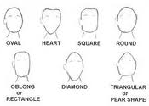
The shape of your face dictates the hair cut and style.

Slide 9






Geometric Facial Shape: | Best Frame Shape: | Frames to Avoid:
Oblong | Full frame with soft curves, or semi-rimless with soft curves | Narrow angular frames
Oval | All frame shapes are good, especially rounded | Any frame that is too small and breaks up the symmetry of your face
Round | Shallow with non-round shape, geometric shapes, semi-rimless | Small or round shape
Heart | Full frame that is narrow at the top and bottom | Frames that are wide at the top, rimless, or semi-rimless
Square | Round frame with soft curves, cat eyes, or oval shapes | Highly angular or square
Triangular/Diamond | Rounded or geometric | Highly angular or square

Slide 10
Height (For Women)
Height (For Men)
under 1.62cm= Short
between 1.62cm and 1.70cm= Average
over 1.70cm = Tall
under 1.72cm= Short
between 1.72cm and 1.80cm= Average
over 1.80cm = Tall
Average Height in Lebanon
Women= 160.8 cm
Men= 174.2 cm

Slide 11
BODY TYPE=
VERTICAL BODY TYPES
HORIZONTAL BODY TYPES

Slide 12
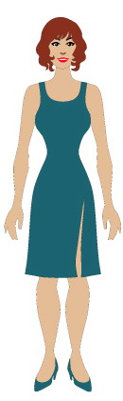
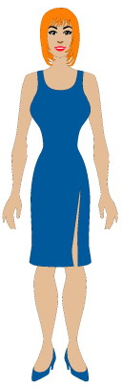
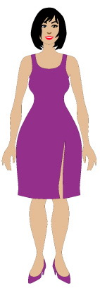
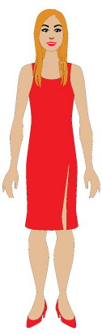
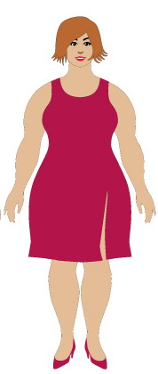
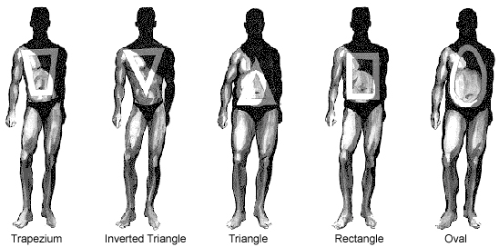

Slide 13
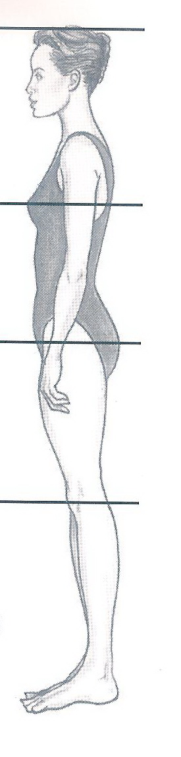
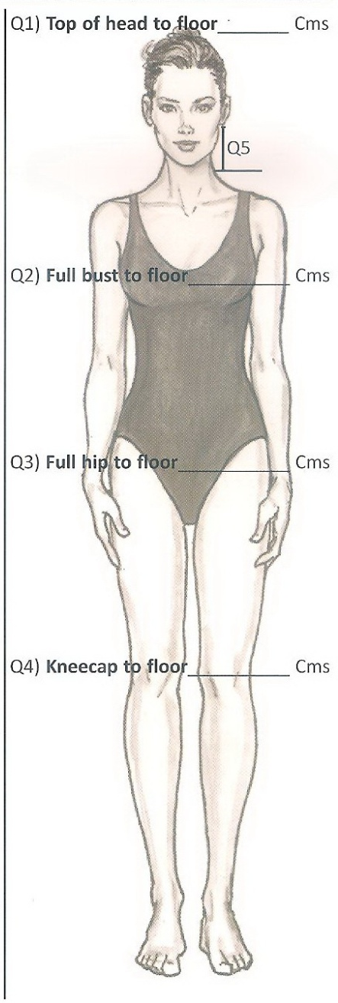
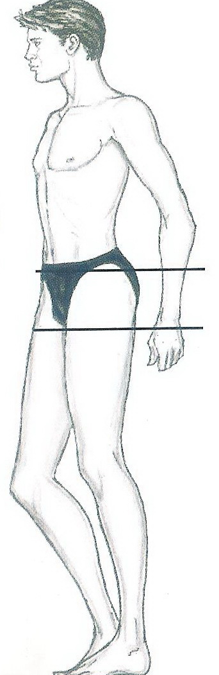
Let us take some measurements…

Slide 14
2- Cloth (Fabric) (please put the arrow on the right answer)
Dark and Matt
Bright and shiny
Soft fabrics
Thick fabrics
Big patterns
Small patterns
Volume
Slimmer
For big figure
Thinner
For small figure
Few more kilos

Slide 15
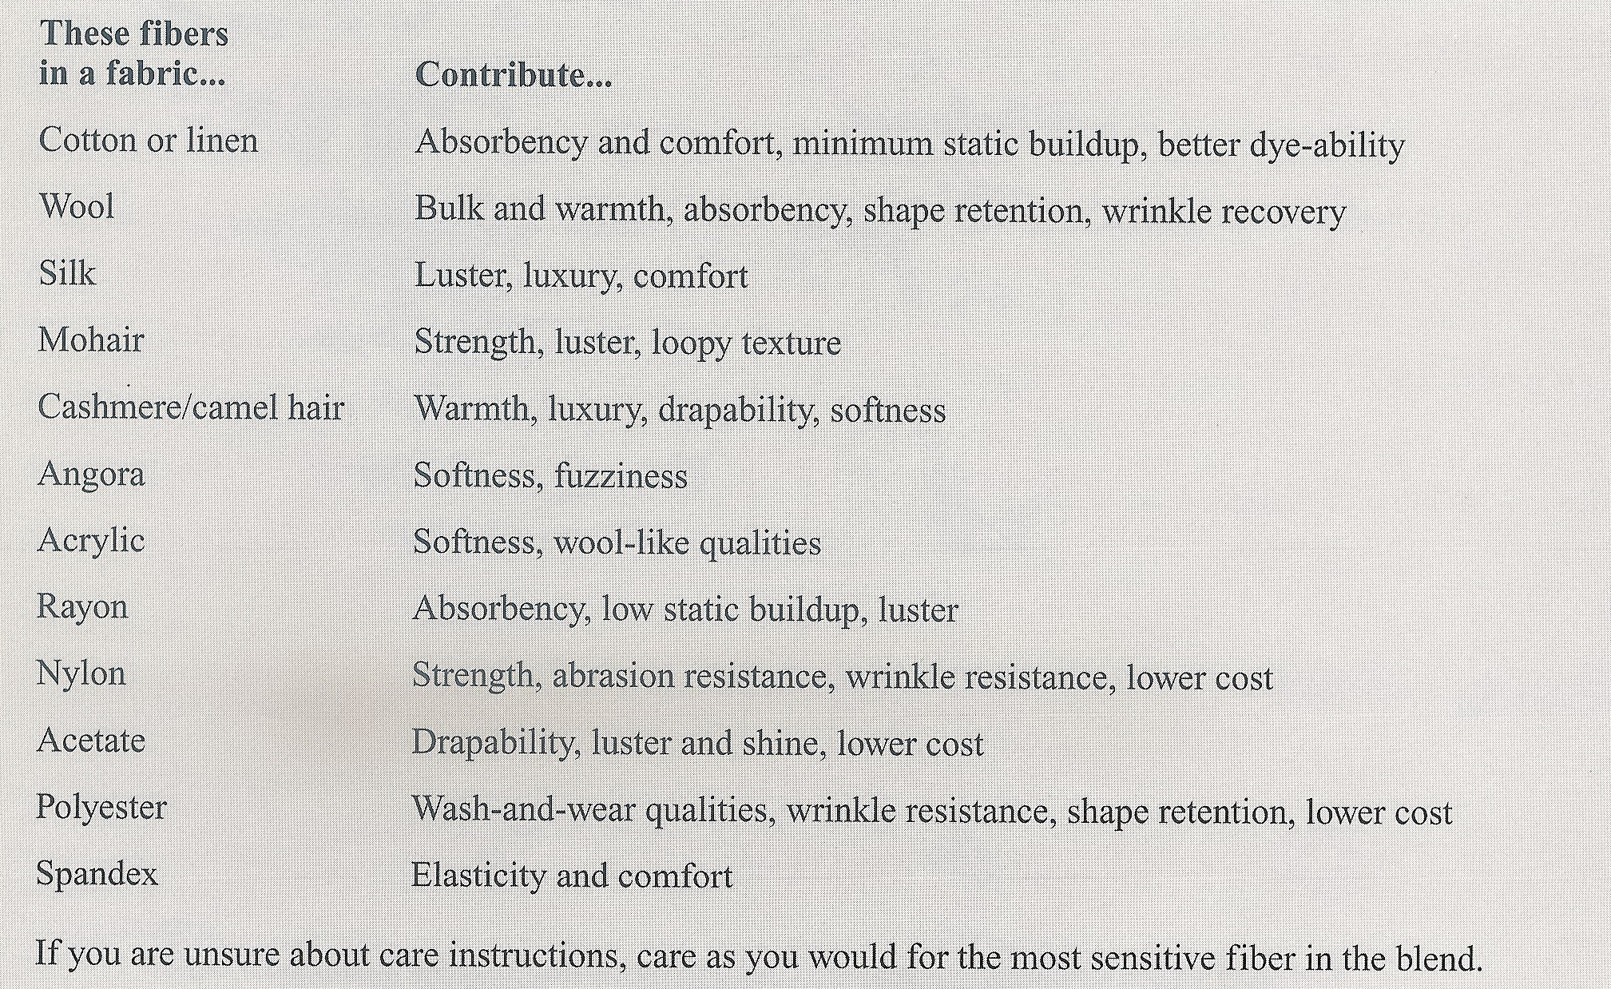
For your info…

Slide 16
Cool/Warm

Slide 17

Cool and warm palette

Slide 18
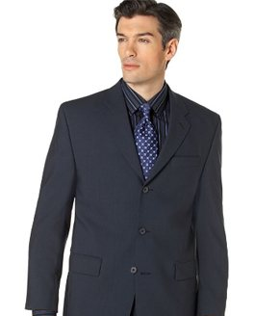
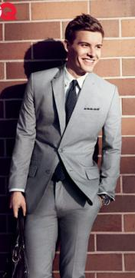
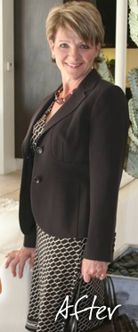
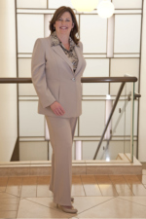
Credibility: Medium Dark to Dark Likeability: Light colors, textured fabrics and mix of unmatched suits.

Slide 19
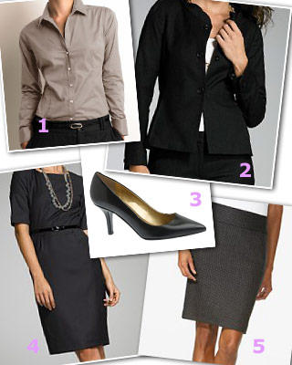
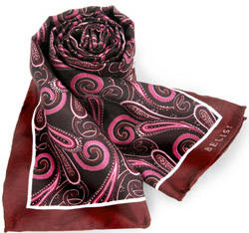
Business Wardrobe for WOMEN
1- Jacket
2- Skirt (preferably lined)
3- 2 to 6 Suits (At least 2 dark color)
4- Blouses (start minimum 4)
5- Sweater (traditional classic)
6- Dress
7- Trouser (2)
8- Accessories (quality pen, scarf , watch and handbag)
9- Coat (winter)
10- Shoes matching lower garments

Slide 20
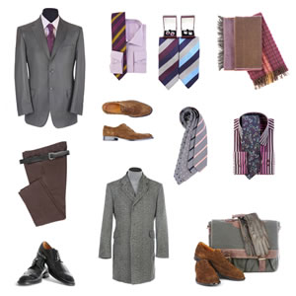
Business Wardrobe for MEN
1- Jacket
2- Ties (minimum 5)
3- 3 to 6 Suits (At least one in a dark charcoal and on in navy)
4- Shirts (minimum 6)
5- Belts matching shoes
6- Trouser
7- Coat (winter)
8- Shoes matching belts and preferably trousers.
9- Scarves (winter)

Slide 21
Good Fit
Summary:
1-Waist and neckline: Enough room for 2 fingers
2- Straight waistlines and hemlines Horizontally
3- Able to lift arms.
4- No clinging or horizontal lines forming.
6- Length to top of shoes.
7- When sitting , skirts should not be too short.
8- Ties’ length reaches top of the belt.

Slide 22
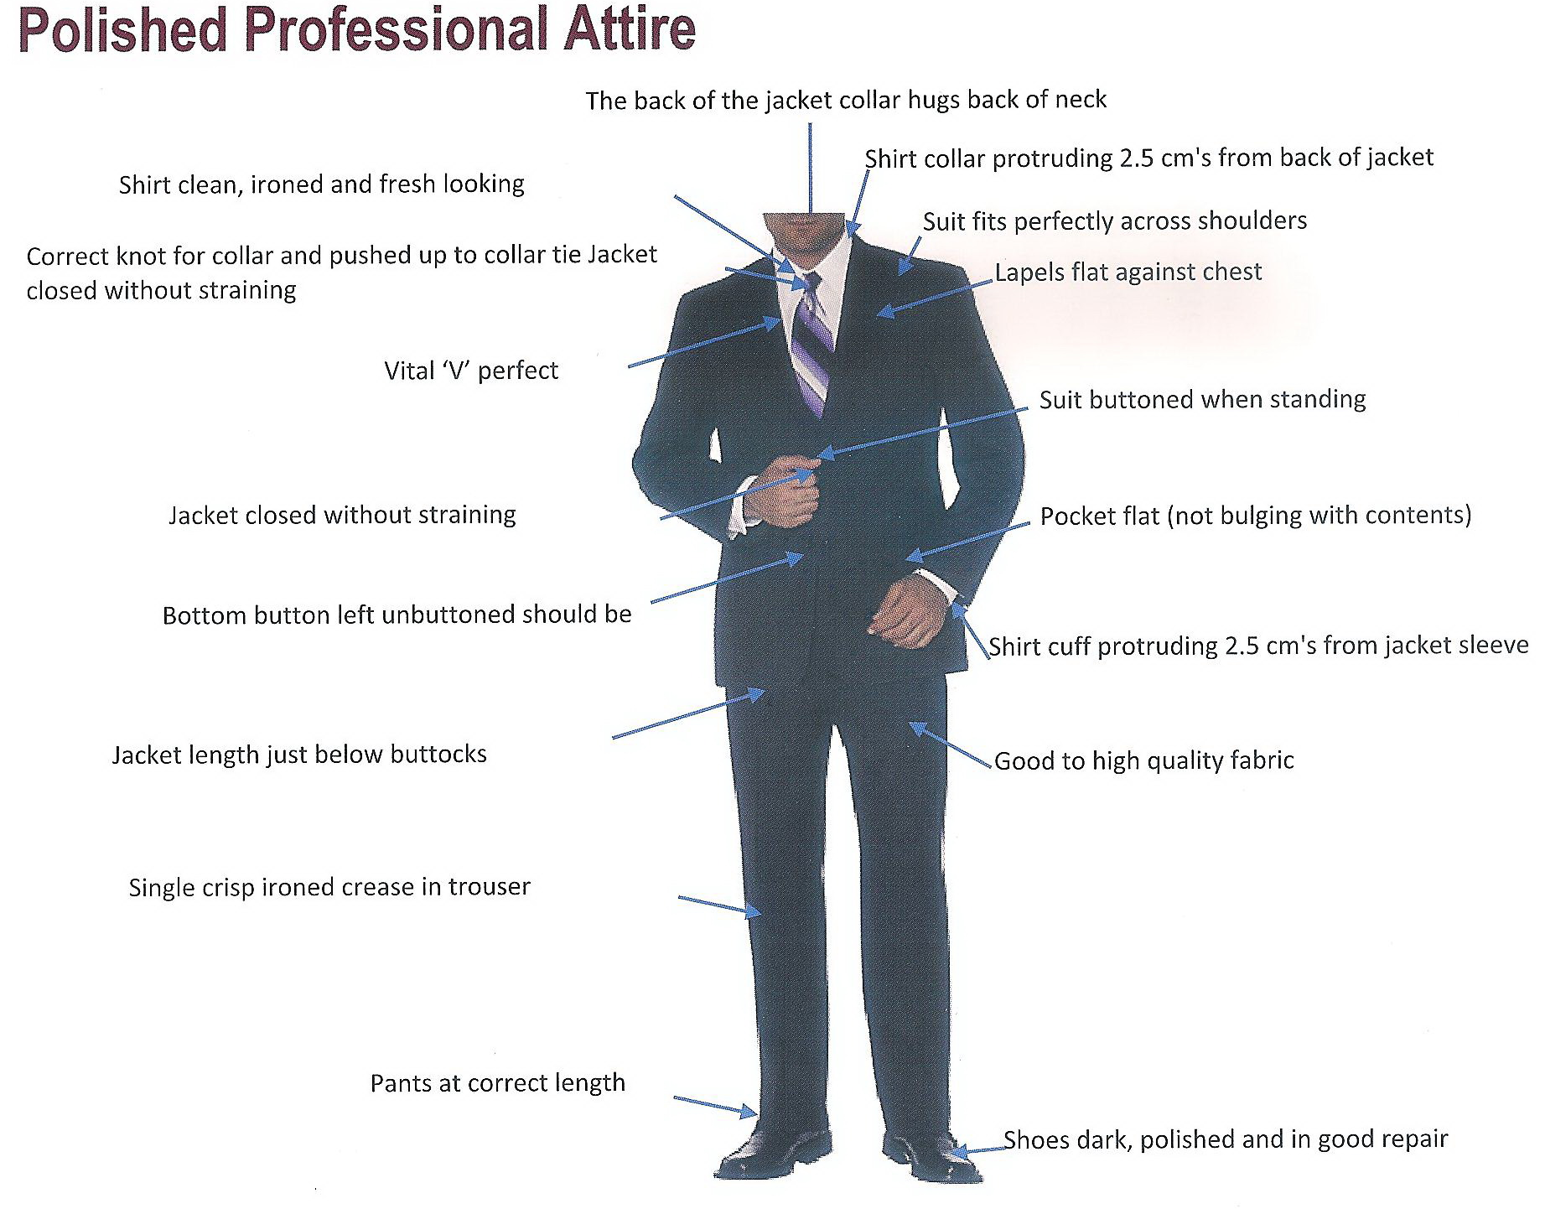

Slide 23
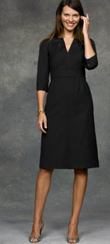
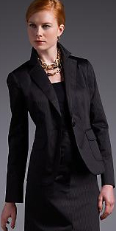
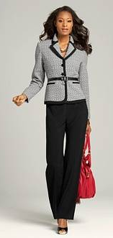

Slide 24
The Accessories

Slide 25
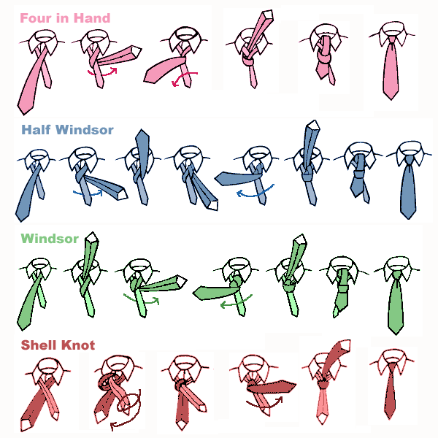
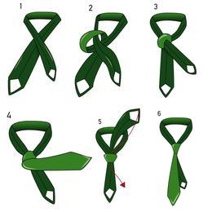
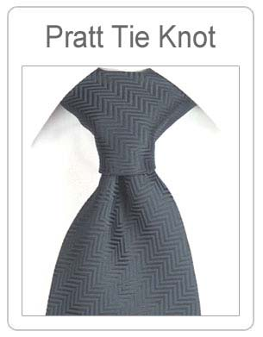
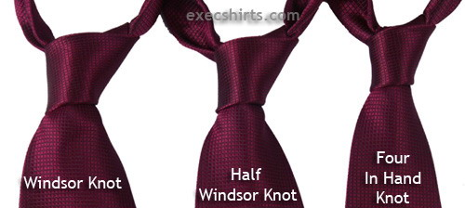

Slide 26
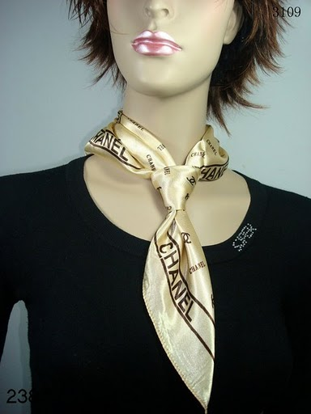
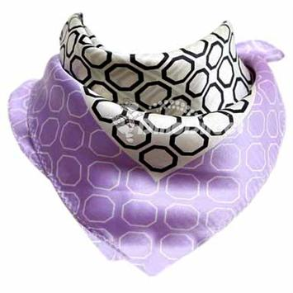
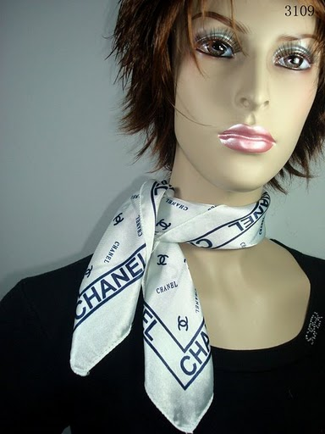
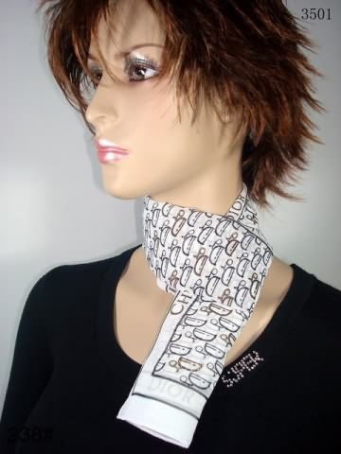
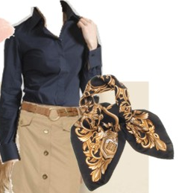
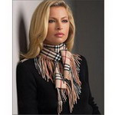

Slide 27
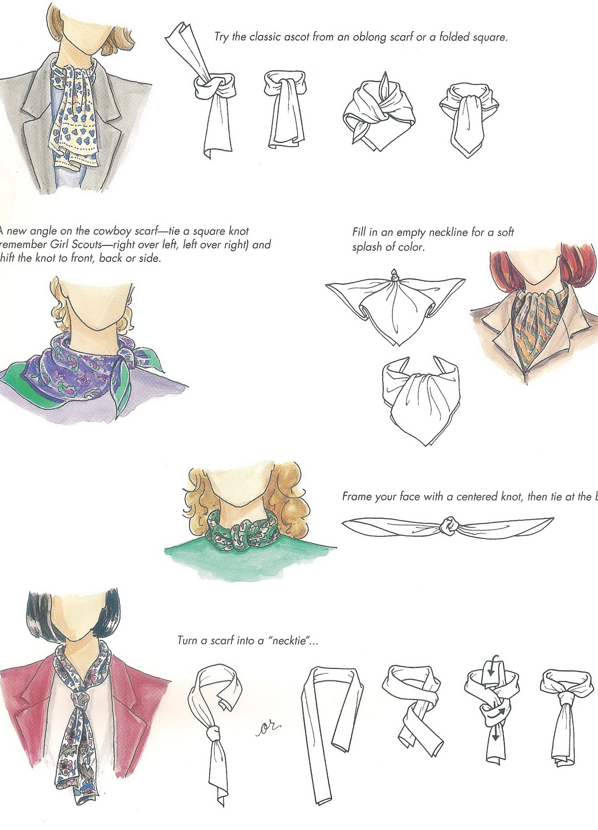

Slide 28
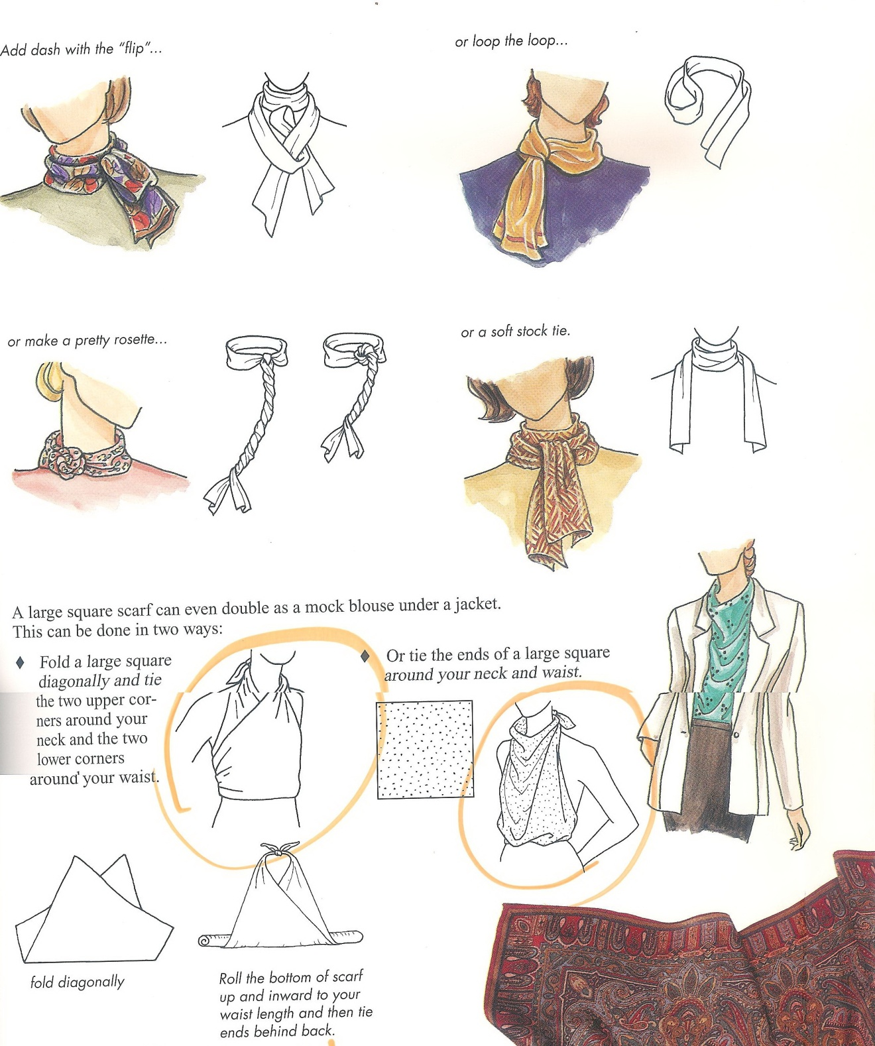

Slide 29
Posture and Body Language

Slide 30
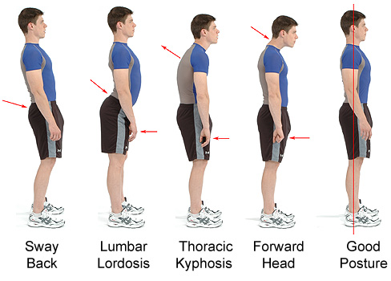

Slide 31
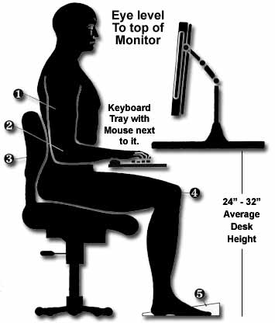
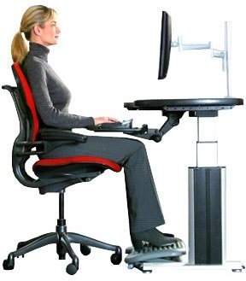
Seated alignment

Slide 32
II- MASTER YOUR BEHAVIOR

Slide 33
Frank Outlaw once said…
Watch your thoughts; they become words.
Watch your words; they become actions.
Watch your actions; they become habits.
Watch your habits; they become character.
Watch your character; it becomes your destiny.

Slide 34
Actions and attitudes

Slide 35

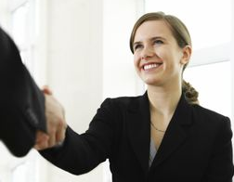

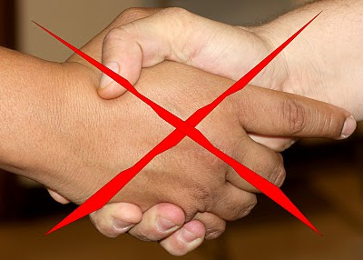

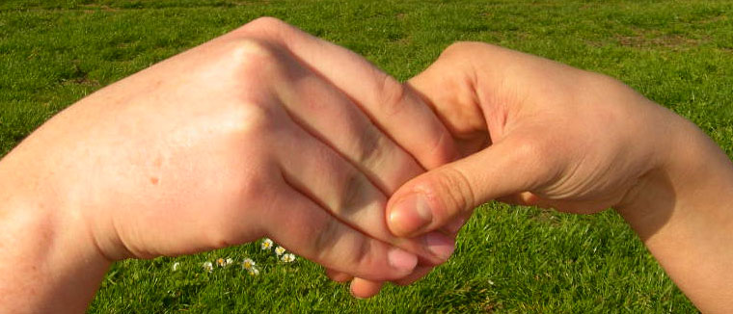
Handshakes talk…

Slide 36
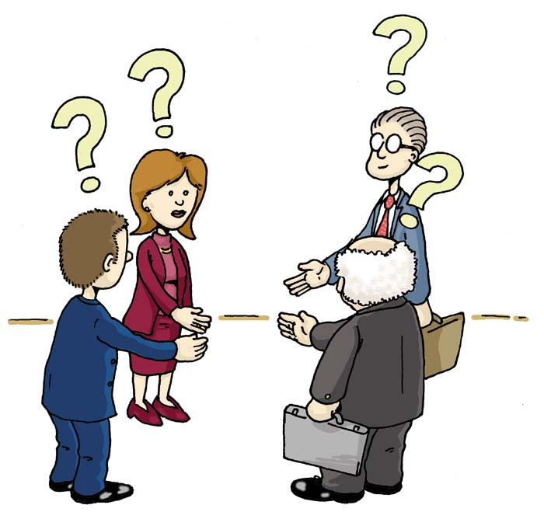
Proper Introductions

Slide 37
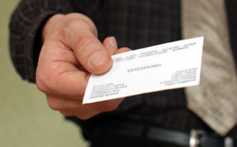
Exchanging Business Cards
Notes:
Never with your left hand!!!!!!

Slide 38
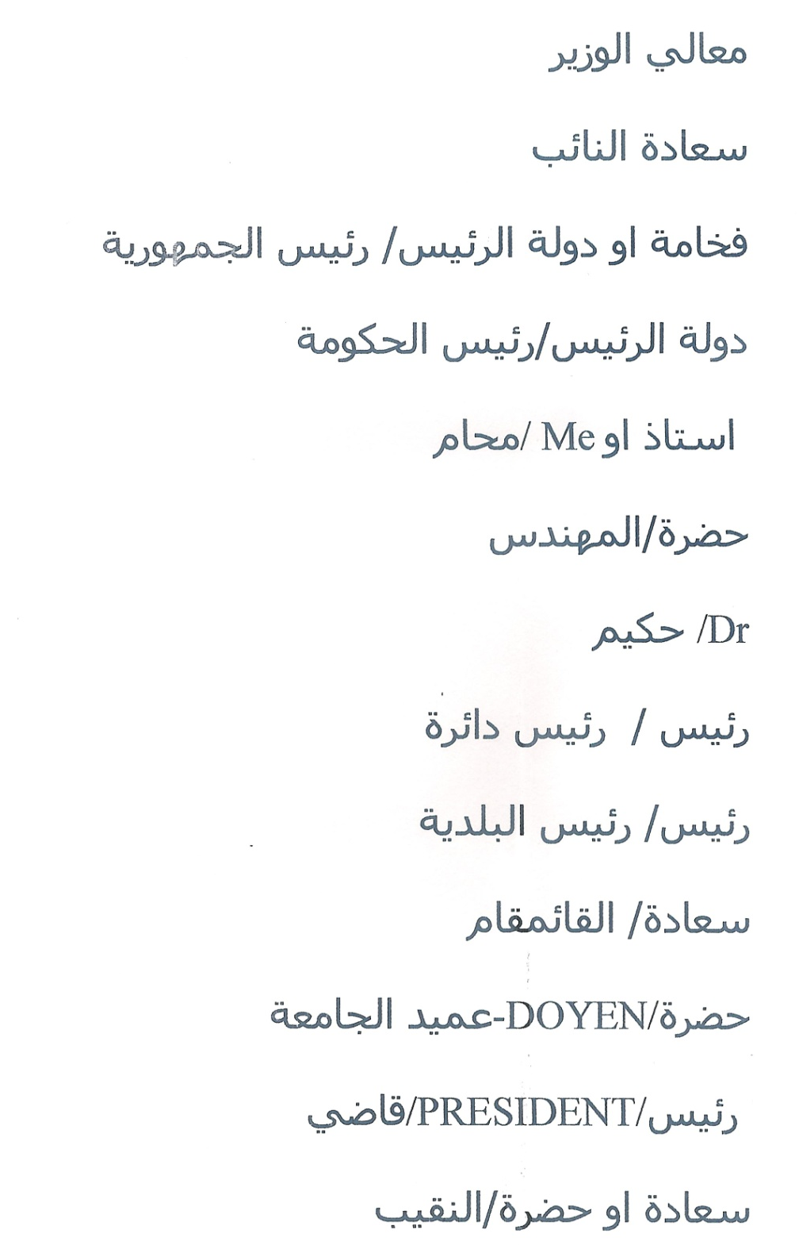

Slide 39
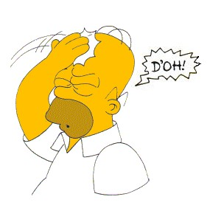


Acknowledge your mistakes, correct them, learn from them, forgive yourself and move on.

Slide 40
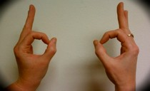
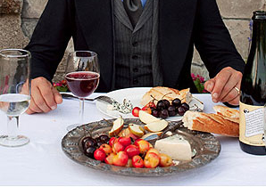
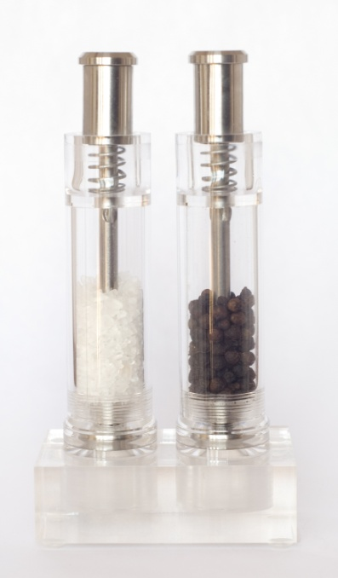
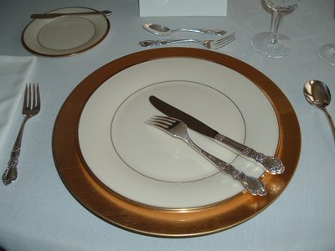
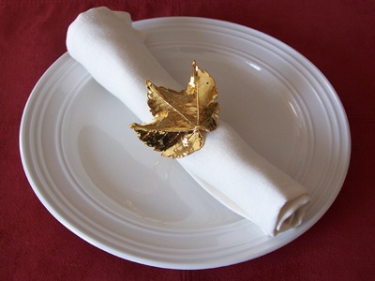
Did you know…?

Slide 41
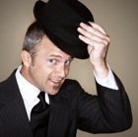


Refined manners: We are Ladies and Gentlemen working with Ladies and Gentlemen.

Slide 42
III- MASTER YOUR ENVIRONMENT

Slide 43







What you should do…

Slide 44

THANK YOU!

