Slide 1
IMAGE =
1- LOOK
2- Behavior
3- Environment
Notes:
Doctor story

Slide 2
FIRST IMPRESSION
55% Visual
(What you wear: how you look and act)
38% Vocal
(How you speak: the tone of your voice)
7%Verbal
(What you say: the words you say)
1- VISUAL
2- VOCAL
3- VERBAL
Notes:
What are they? Can you guess the percentage? (by Albert Mehrabian one of America’s foremost social psychologist)

Slide 3
MASTER YOUR IMAGE =
1- Master Your LOOK (appearance)
2- Master Your Behavior (action + attitude)
3- Master Your Environment
(office + car + dining)
Notes:
Doctor story

Slide 4
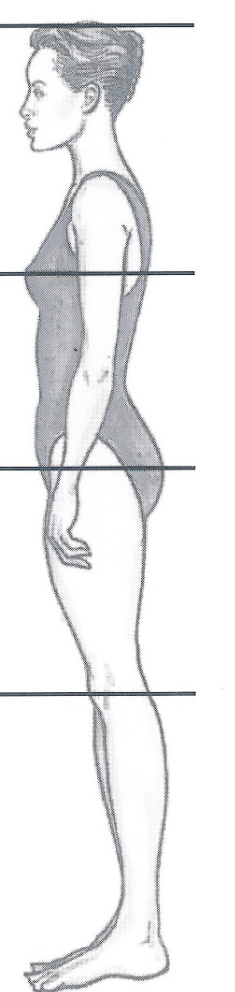
Tips for Balanced body women
Waistbandless / narrow bands on skirts and pants
Narrow to medium width belts
Dress, skirt and pant waistlines that sit just above or below the natural waistline
Dresses that flow through the waist
High to mid body focal points
Medium-low to high heels
Shoes and sandals that expose a lot of foot

Slide 5
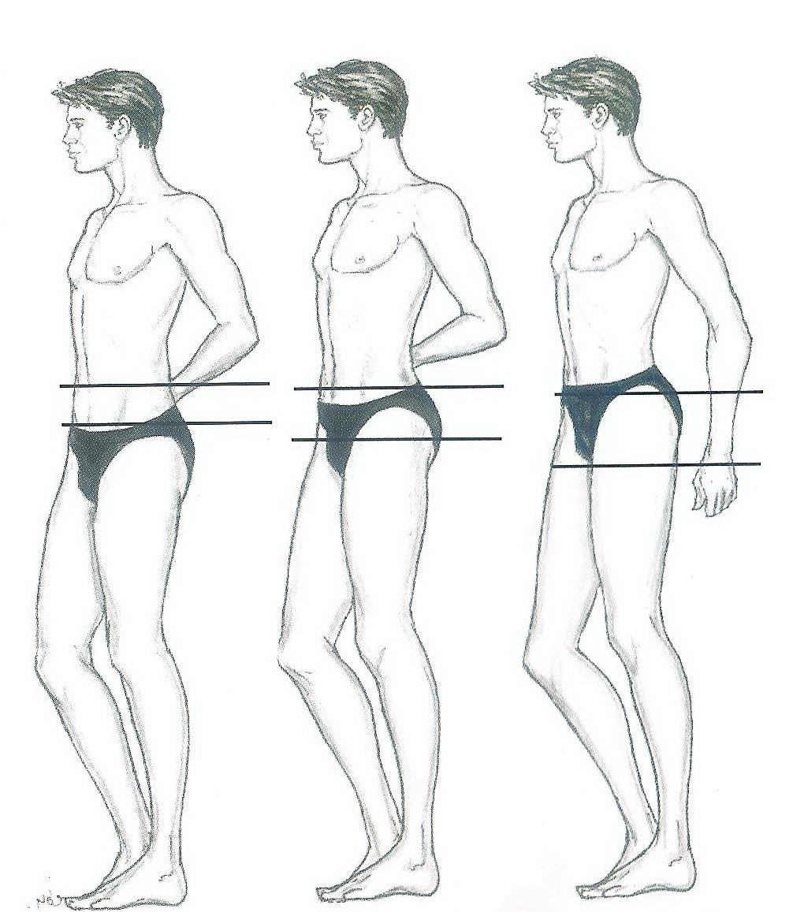
Balanced body for Men
This body is the easiest to dress.
Height, weight, bone structure, age and prominent features will have to be considered.

Slide 6
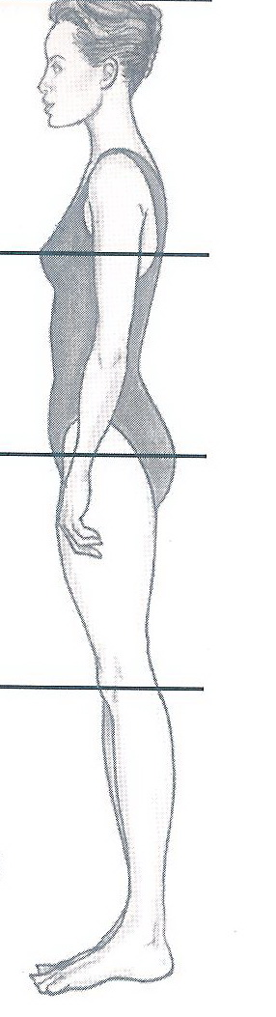
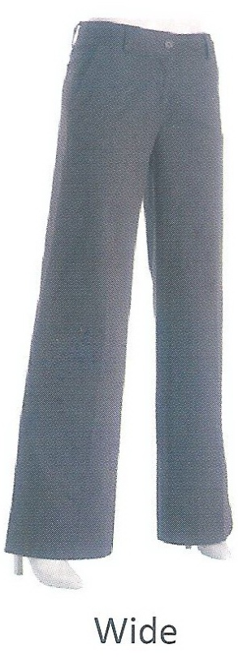
Tips for Long legs/ short torso women
Low hip and longer over blouses, tops and jackets
Eyes down accessories
Skirts and pants without waistbands
Medium to wide pants and skirts
Narrow non-contrasting belts
Dresses that flow through the waistline
Long-line accessories
Contrast between hemline, legs and shoes
Long shorts and cut-off pants
Low to medium-high heels

Slide 7
Tips for Long legs/ short torso men
Pants are easy to find.
Jackets, T-Shirts, and sweaters that are short enough to their arm lengths are hard to find.

Slide 8
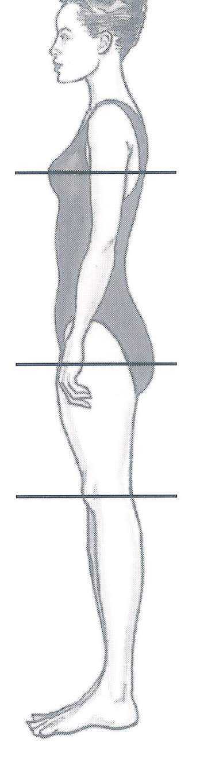
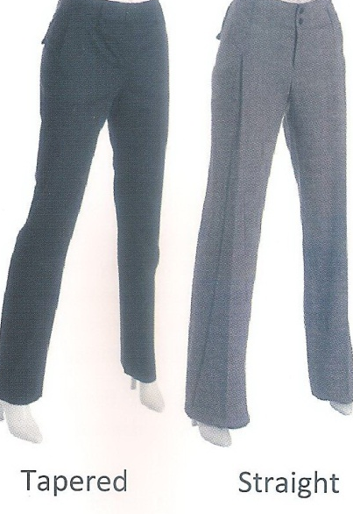
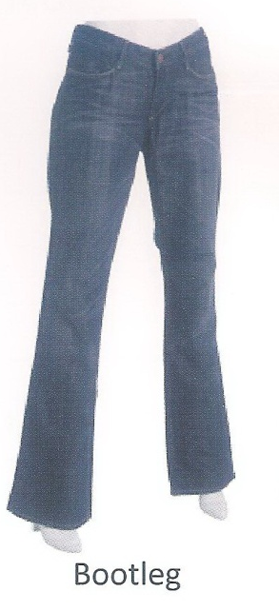
Tips for short Legs/Long Torso women
Eyes-up accessories
Straight skirts
Waistlines just above natural waist
Low contrast between hemline, legs and shoes
Medium to wide belts
Waisted as well as non - waisted dresses
Slim-line, tapered, straight or bootleg
Medium to high heels
Short to medium length dress, pant and shorts
Shoes and sandals that expose a lot of foot

Slide 9
Tips for short Legs/Long Torso men
Men are lucky to have a variation in leg trousers’ length.
Normally sleeves need to be adjusted unless men are tall.
Provided those Men do not have a large stomach, they will look better in shorter style Jackets.

Slide 10
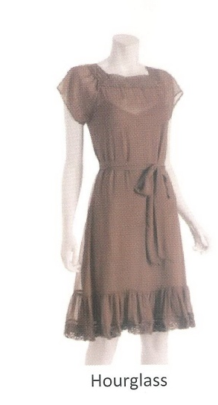

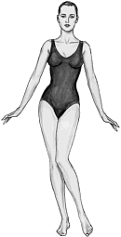
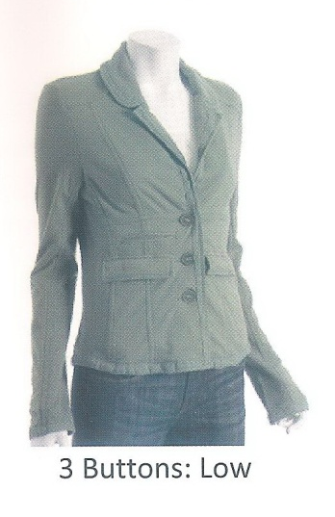
X
A woman with this shape is fortunate, as weight gain or loss is evenly distributed and will often go unnoticed for a long period of time. Clothing is often easy to fit and find.

Slide 11
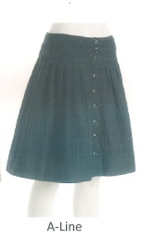
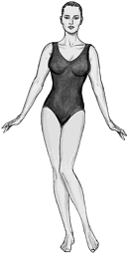
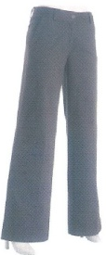
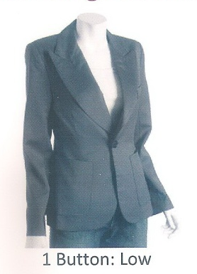
An X shape appearance can be created by increasing the visual width below the waist using:
A-line skirts,
Bold textures,
Horizontal stripes,
Fuller leg width in trousers.
Minimizing the upper body with:
Open necklines and collars,
Vertical stripes,
Single-breasted jackets,
Garments that are smooth in texture
Garments that drape fluidly over the body.
Y

Slide 12
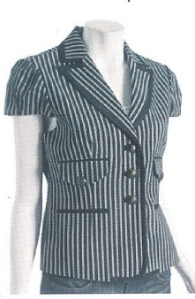
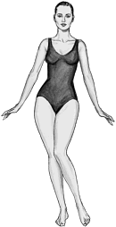

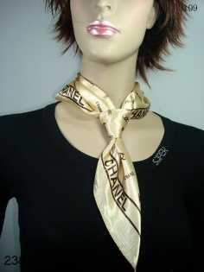
-To provide the illusion of an X shape figure, width needs to be created in the upper body to balance the lower half. Subtle (non visible) shoulder pads are a slimming accessory (even when not in fashion), especially if her shoulders have a strong slope. Other slimming strategies include: -Smooth fabrics below the waistline, -Darker colors for skirts and pants, -Slightly tapered or bootleg trousers, -High placed accessories, -Medium to high heels.
A

Slide 13
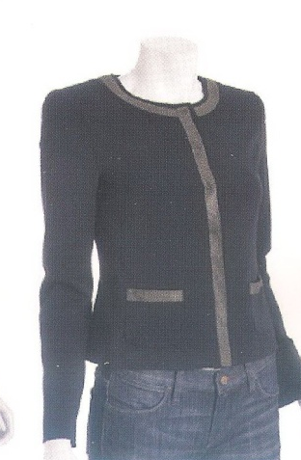
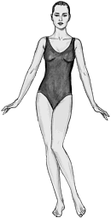
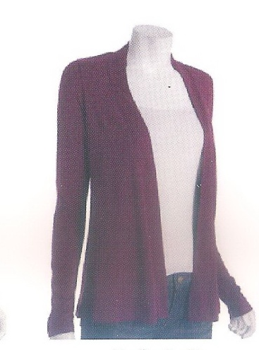

-Shoulder pads, - Color blocking (to create the illusion of a waist), -Open single-breasted jackets, vests, -Soft fabric tops and matching skirts.
H

Slide 14
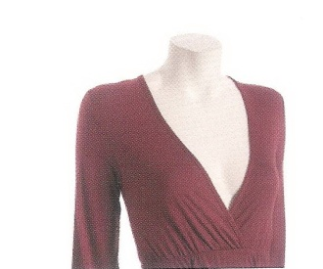
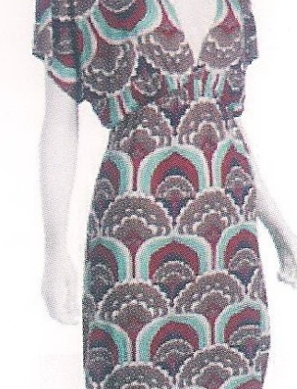

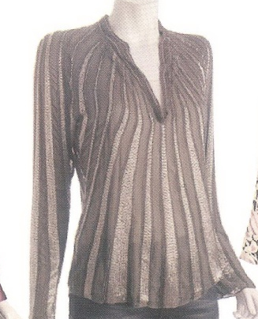
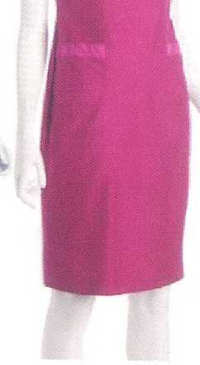
This shape belongs to full figured women who have a round shape and a low stomach. A pleasing silhouette is created by: -Garments and outfits that have a subtle inverted triangle shape, ‘V' necklines, -Vertical design lines, -Medium-sized non shiny prints, -Abstract and geometric patterns -Medium to dark colors, -High placed focal points, -Medium to medium-high heels, -Below knee-length skirts, -Hosiery that blends with the shoes and hemline.
O

Slide 15
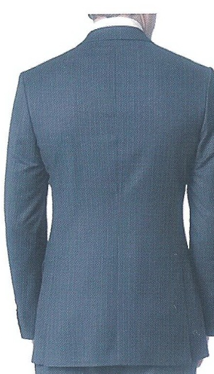
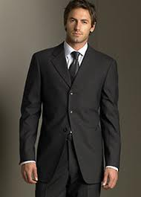
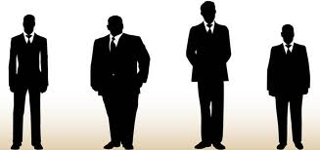
LARGE What You Need To Know -There's a way to dress that flatters every body type, and large body types are no exception. -Baggy clothing does not hide extra pounds and tight clothing fails to rein it in. -Proper fit is essential for dressing your body type. -Single-breasted blazers -Three-button suit/blazer -Blazers with a single vent or no vent -Flat-front pants -V-neck T-shirts and sweaters -Dark colors -Dressy knee-length coat -Sweaters in thin fabrics -Dress shoes with a slight heel -Horizontally-striped shirts -Dark-rinse relaxed-fit jeans LARGE

Slide 16
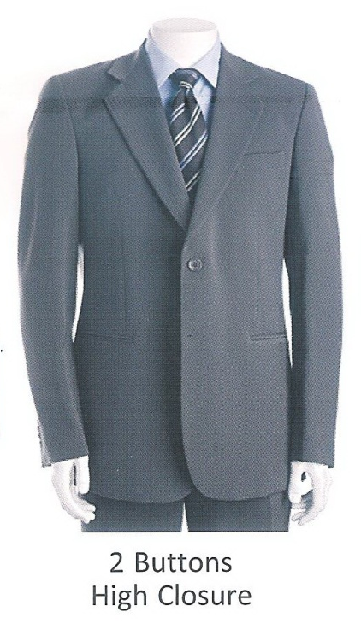
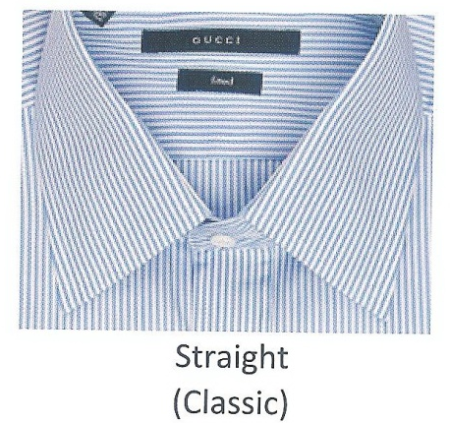
SHORT What You Need To Know A short body type is defined as a height under 170cm. Fit is critical; make friends with the tailor. Dressing in the same color family elongates your body. -Two-button coats and blazers -Boot-cut or straight-leg jeans -Slim ties -Straight-point collar button-downs -Narrow belt -Single-breasted, vent less blazers -Sleek suits -Sweaters in thin fabrics -Shoes and boots with 1cm to 2.5cm heel
SHORT

Slide 17
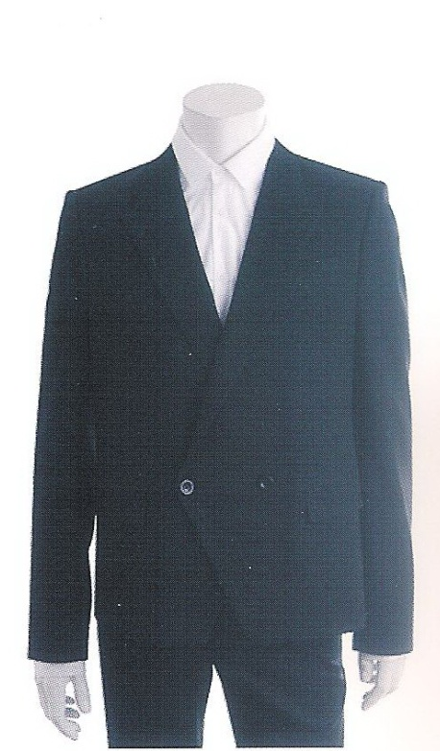
TALL What You Need To Know -Favor straight-leg trousers, two-button blazers and don't forget to have clothes tailored. -Avoid wearing the same color head to toe - break you body up with color and pattern. -Double-breasted blazers and jackets -Turtleneck shirts and sweaters -Wider ties and belts -Custom-tailored suit -Just-below-the-knee coats with belts -Straight-leg trousers and jeans -Hip-length two-button blazers -Thin-soled shoes
TALL

Slide 18

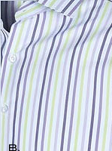
SKINNY What You Need To Know -Make friends with EU imports like H&M and Zara. -Contrary to popular belief, vertical stripes can make you appear larger. -Fashion trends were designed with your body type in mind - take advantage of it. - Double Breasted blazers and jackets -Heavy-knit sweaters -Crew-neck tees -Straight-leg or slim boot cut jeans -Flat-front trousers -Single or double-button blazers -Vertically striped dress shirts -Military-style jackets
SKINNY

Slide 19
Determining Colors Factors
Skin Undertones
Blue (Cool) - Sallow or Olive, Fair to Black
Yellow (Warm) - Milky, Golden Freckles
Hair
Cool - Light to Dark Blonde, Light to Dark Brown and Black
Warm - Light to Dark Golden or Honey Blonde, Light to Dark Warm Brown, Strawberry to Deep Copper Red
Eyes
Cool - Light to Dark Blue, Hazel, Green or Brown
Warm - Turquoise to Blue Green, Hazel, Green or Brown

Slide 20
Good Fit
Summary:
1-Waist and neckline: Enough room for 2 fingers
2- Straight waistlines and hemlines Horizontally
3- Able to lift arms.
4- No clinging or horizontal lines forming.
6- Length to top of shoes.
7- When sitting , skirts should not be too short.
8- Ties’ length reaches top of the belt.

Slide 21
Introduce the “less important” person to the “most important” person: (Mention the name of the higher status person first)
Mr. Haddad, I’d like to present my daughter Mona.
Mona, this is Mr. Kamal Haddad, the president of our company.
Notes:
Use last names unless invited other wise

Slide 22

Voice
Speak clearly.
Live your words.
Articulate and pronounce your words well.
Show confidence by lowering your tone.
Pause a moment before important points.
Rely on vocal variety by changing your tone and voice level.

Slide 23
Phone Etiquette
1- Always answer with a smile.
2-Answer within 3 rings.
3- State the company’s name.
4- Greet with good morning, good afternoon or good evening.
5- State your name.
6- Never address a caller as well as employees by his or her first name.
7- Ask if you may take a message if the person needed is away from his or her desk.
8- Take specific detailed message on paper.
9- Have a brief summary before you hang up.
10- For transfers…Listen to what or who the caller needs and then ask if you may transfer him or her to the proper person that could help.
11- Never transfer a call without informing the person you are transferring to that he or she has a phone call and if possible giving them the name and reason to the call.
12- Always finish the call with a thank you.
13- Never hang up before the caller hangs up.

Slide 24
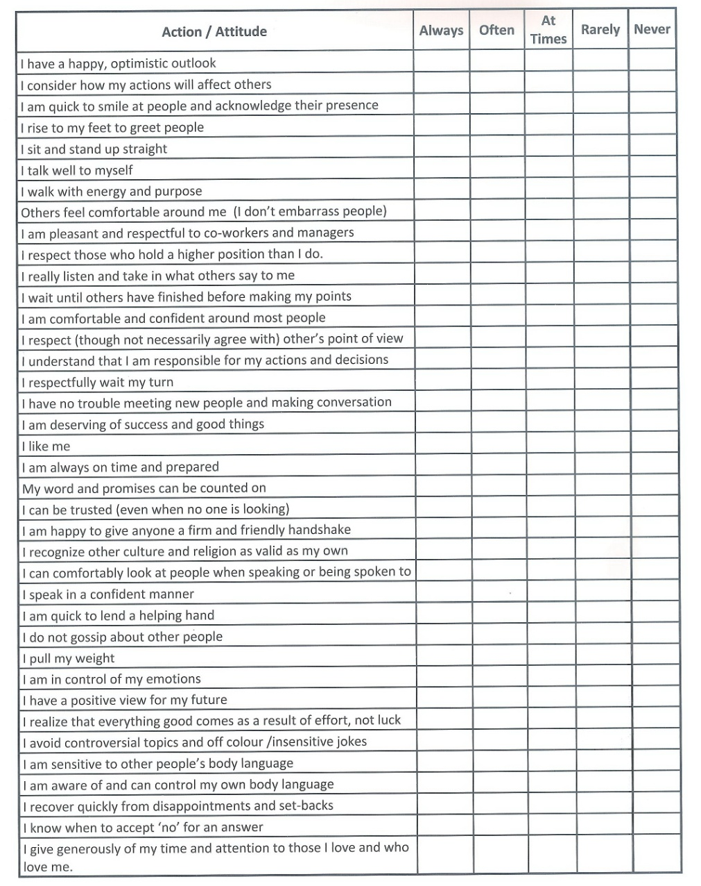
Action and attitude check up list

Slide 25
What you should not have or do…
Smoke or have any cigarette buts in your office.
Have a very messy desk.
Have a dirty desk.
Have an unorganized desk.
Have too many family photographs or children artwork.
Have non work related magazines.
Eat at your desk.
Inappropriate posters.
Religious materials.
Leave an unclean shared kitchen.
Have an unclean car
Notes:
10

