Slide 1
MASTER YOUR IMAGE
Prepared by Janine E. Asmar fashion designer image consultant
Notes:
By Janine E. Asmar

Slide 3
What is image?
Why is image important?
HOW CAN IT AFFECT OUR LIVES?
How to build and control our image?

Slide 4
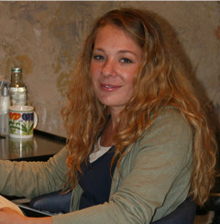
Who is she?
Picture # 1

Slide 5
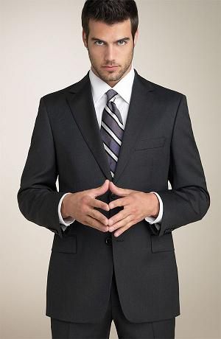
Who is he?
Picture # 2

Slide 6

What do you think about him?
Picture # 3

Slide 7
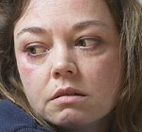
How about her?
Picture # 4

Slide 8
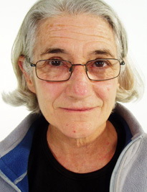
Can you guess her age?
Picture # 5

Slide 9
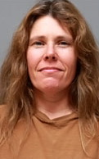
Her position?
Picture # 9

Slide 10
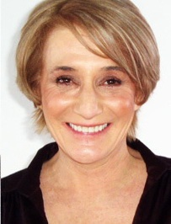
And this one?
Picture #7

Slide 11
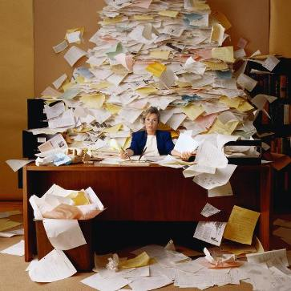
What does this image say?
Picture # 8

Slide 12
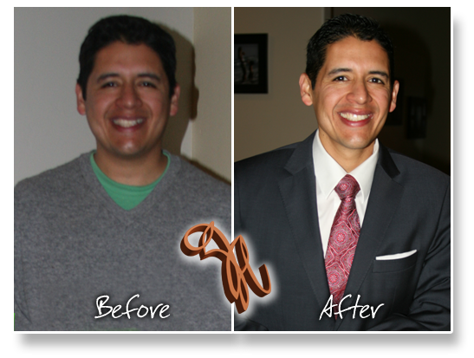
What salary would you propose?
Picture #9

Slide 13
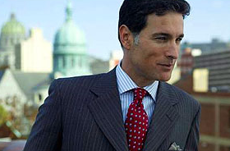
…how about his salary?
Picture #10
Notes:
Picture #1 and #10 printed: Let us imagine 2 separate conversations…

Slide 14
What is Image?

Slide 15
IMAGE is
HOW others SEE YOU.

Slide 16
IMAGE =
1- LOOK
2- Behavior
3- Environment
Notes:
Doctor story

Slide 17
Why is Image important?

Slide 18

1- It influences how other react and behave towards us…

Slide 19
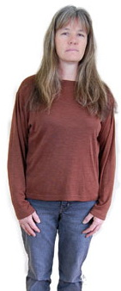
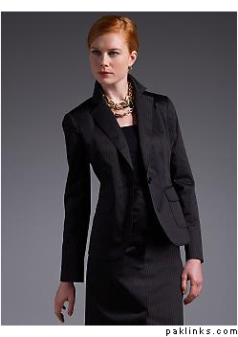
If you present yourself visually and behaviorally as a successful person, others will respond to you accordingly.

Slide 20

If you present your work environment visually and behaviorally as a successful and trustworthy environment , others will respond to you accordingly.

Slide 21
2- Builds Self-esteem/Self Respect
SELF IMAGE
Builds
Controls
PERFORMANCE
SELF TALK
Stimulates

Slide 22
Most important impression is the FIRST impression…
WHY?
1- You might not get a second chance.
2- Extremely difficult to change.

Slide 23

1- First Impression
30 seconds …

Slide 24
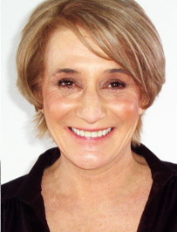
In 30 seconds people has judged you and decided whether they like you, whether they trust you and whether they will work with you.

Slide 25
FIRST IMPRESSION
55% Visual
(What you wear: how you look and act)
38% Vocal
(How you speak: the tone of your voice)
7%Verbal
(What you say: the words you say)
1- VISUAL
2- VOCAL
3- VERBAL
Notes:
What are they? Can you guess the percentage?
(by Albert Mehrabian one of America’s foremost social psychologist)

Slide 26
LOLO effect
Lock On what we believe is true
Lock Out anything to the contrary

Slide 27
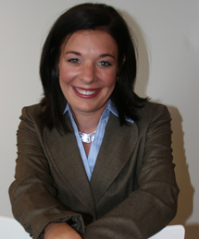

Slide 28
Notes:
(American University study)

Slide 29
Our image has a direct affect on how…
WE…
And most IMPORTANTLY on how OTHERS
Feel
Think
Act
Will feel
Will think
Will act
… towards us.

Slide 30
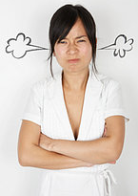
Stories???

Slide 31
How can image change our future?
Better Business
Better Position
Better Money
Better Lifestyle
Better Image
Notes:
Some examples please

Slide 32
How would you like to be perceived?
(please write down a minimum of 10 impressions of what you would like YOUR image to say)

Slide 33
Knowledge Credibility Attractiveness Health
Accomplishments sUCCESS
Elegance Self respect Persuasiveness
Confidence Sense of Organization
Competence COMMUNICATION
Sophistication TRUSTWORTHINESS
    Self-esteem
Professionalism Authority Beliefs AGE
rEPUTATION Power Position
Likeability Energy Friendliness

Slide 34
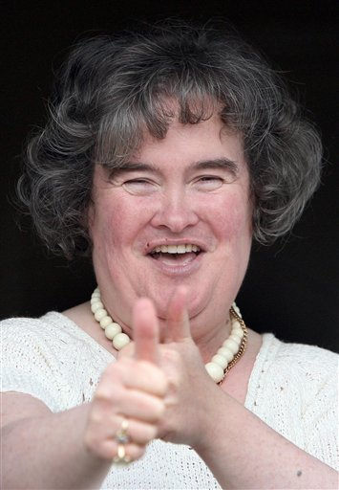
Susan Boyle

Slide 35
How about we analyze some before and after pictures…

Slide 36
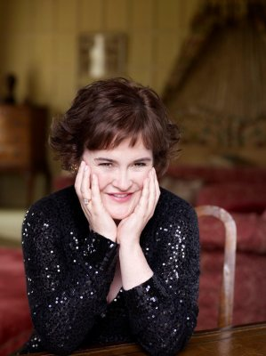

Slide 37
How did she change?

Slide 38
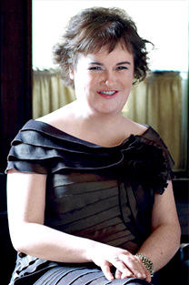
How did she change?..
1- Lost weight
2- Changed her hair’s color and cut
3- Defined her eyebrows
4- Put make up
5- Feminine gesture
6- Dark and refined dress
7- Skin glow
8- Hands and nails
9- Accessories
10- Eyes (the look)
11- Smile
12- Posture

Slide 39
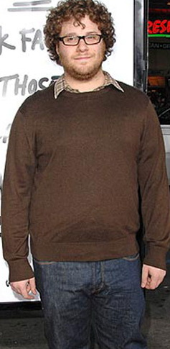
Proper Changes For Seth Rogen going to a Conference…
1- Hair
2- Eye Wear
3- Suit
4- Tie
5- Dark Color
6- Weight
7- Beard
8- Belt

Slide 40
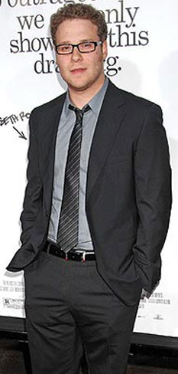
Results..
1- Hair
2- Eye Wear
3- Suit
4- Tie
5- Dark Color
6- Weight
7- Beard
8- Belt
9-Body language

Slide 41
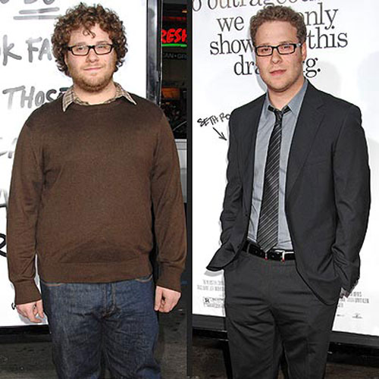

Slide 42
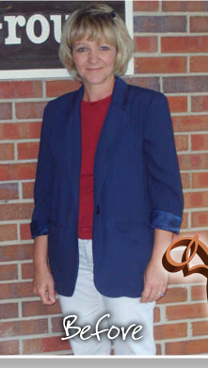
What would you change?
1- Hair: cut and color
2- Outfit
3- Color of outfit
4- Accessories
5- Posture
6- Make up
7- Neckline

Slide 43
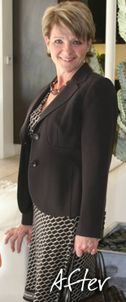
1- Hair: cut and color
2- Outfit
3- Color of outfit
4- Accessories
5- Posture
6- Make up
7- Neckline

Slide 45
Building your image…

Slide 46
IMAGE =
1- LOOK
2- Behavior
3- Environment
Notes:
Doctor story

Slide 47
MASTER YOUR IMAGE =
1- Master Your LOOK (appearance)
2- Master Your Behavior (action + attitude)
3- Master Your Environment
(office + car + dining)
Notes:
Doctor story

Slide 48
MASTER YOUR LOOK

Slide 49
I- THE head
II- THE BODY
MASTER YOUR LOOK=

Slide 50
I- THE HEAD

Slide 51
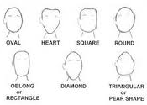
The shape of your face dictates the hair cut and style.

Slide 52

HOW TO DETERMINE YOUR FACIAL SHAPE?

Slide 53






Geometric Facial Shape: | Best Frame Shape: | Frames to Avoid:
Oblong | Full frame with soft curves, or semi-rimless with soft curves | Narrow angular frames
Oval | All frame shapes are good, especially rounded | Any frame that is too small and breaks up the symmetry of your face
Round | Shallow with non-round shape, geometric shapes, semi-rimless | Small or round shape
Heart | Full frame that is narrow at the top and bottom | Frames that are wide at the top, rimless, or semi-rimless
Square | Round frame with soft curves, cat eyes, or oval shapes | Highly angular or square
Triangular/Diamond | Rounded or geometric | Highly angular or square

Slide 54
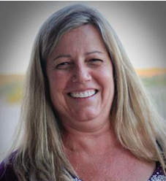

Hair cut and color
P.S. Please be aware of white roots!!!

Slide 55
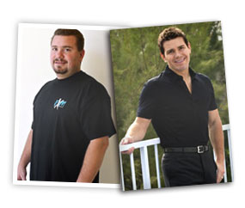

Slide 56
Let us talk about excess hair…..!!!!

Slide 57
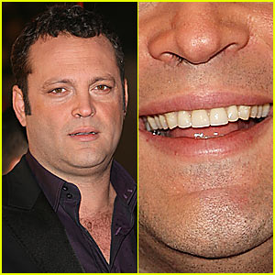
Please pluck all excess hair!!!
Nostrils

Slide 58
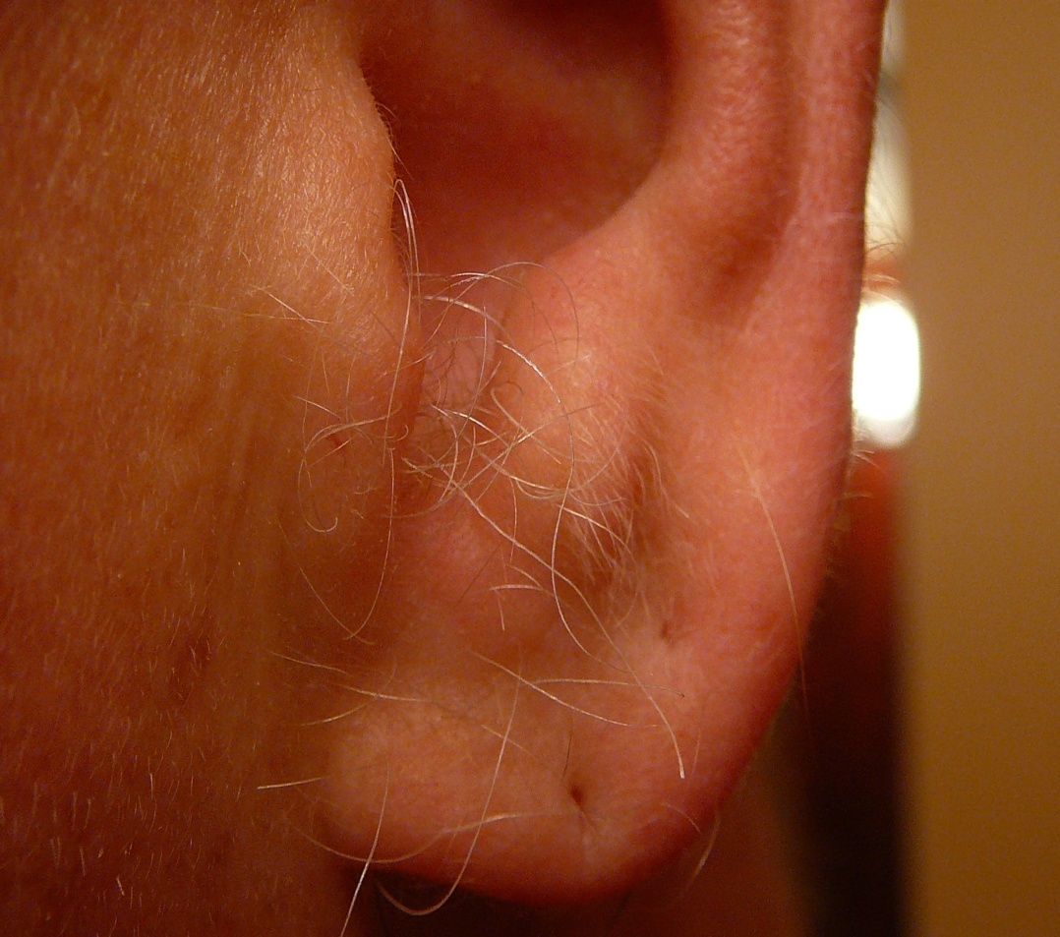
Please pluck all excess hair!!!
Ears

Slide 59
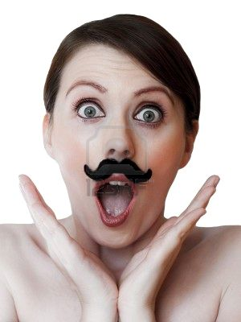
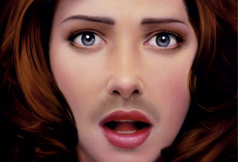
Ladies…

Slide 60
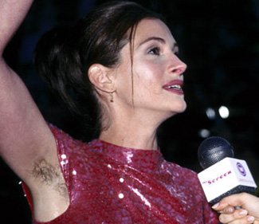
It might not be part of the face but it affects it a lot!!!
You don’t look at the face anymore!!

Slide 61
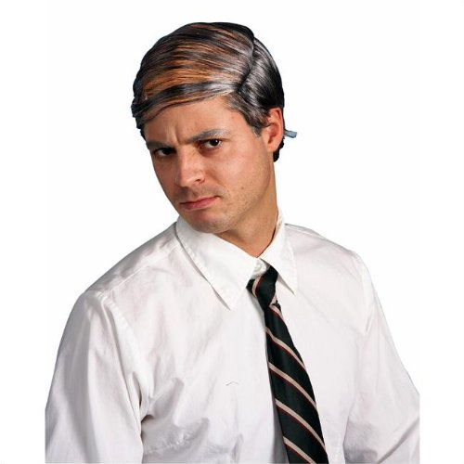
PLEASE don’t!!!!!

Slide 62
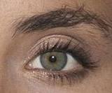
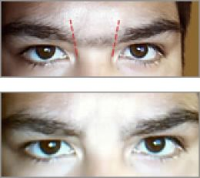
Eyebrows

Slide 63
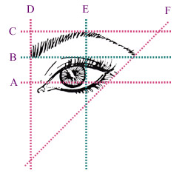
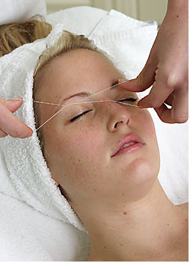
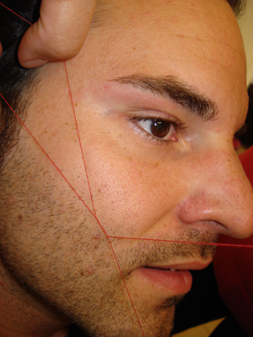
A quick technique…

Slide 64
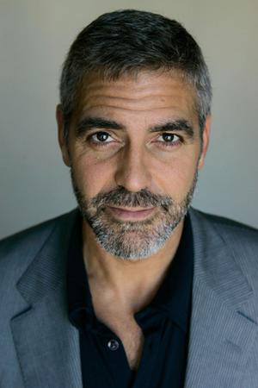
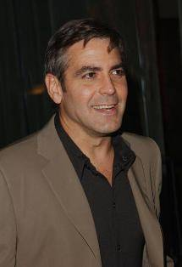
Beard and Moustache

Slide 65
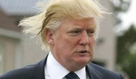

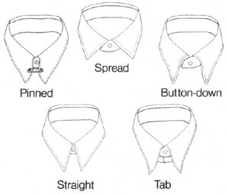
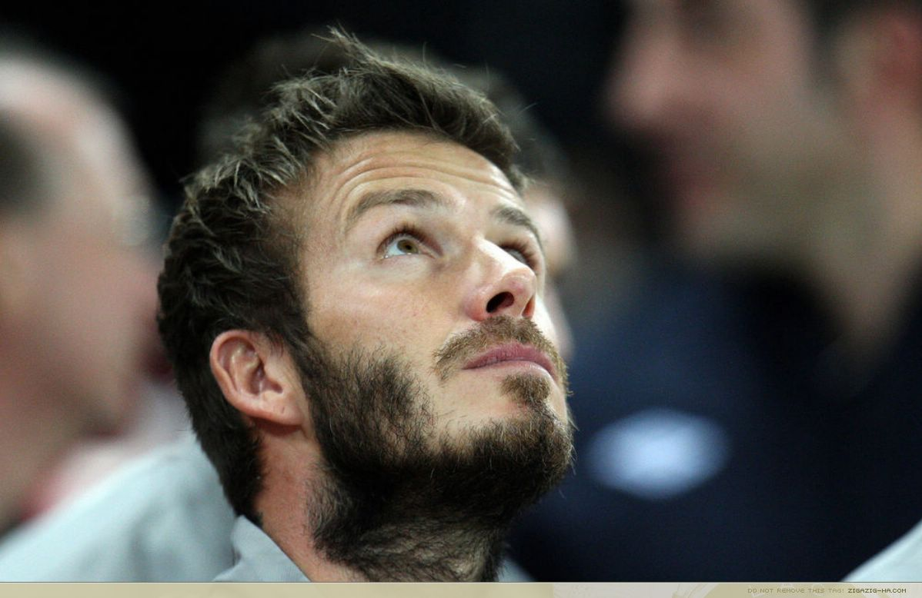
Neck and collars

Slide 66
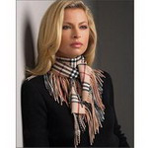
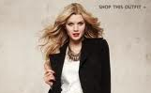
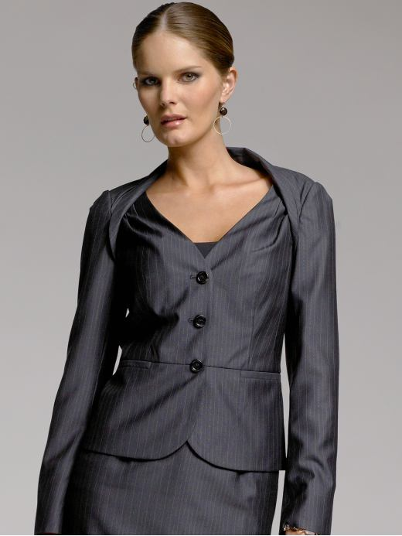
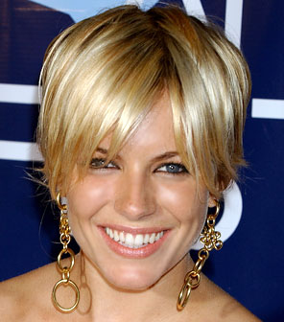
Notice the neck..

Slide 67
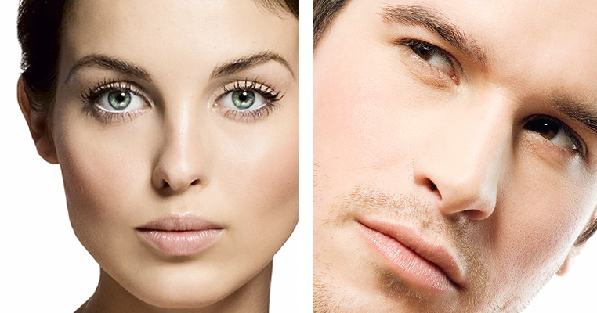
Your skin…
Sick or Healthy?

Slide 68
What should you do to have a good skin?
1- Wash your face twice daily. Apply face wash to wet skin. Use warm water to rinse.
2- Use Moisturizers with SPF protection of at least 15. Determine skin type: oily, dry, combination or normal.
3- Scrub once or twice a week. Buffs away impurity and dead cells. Perfect pre-shave tool for lifting hairs away from the skin.
4- Masks. Purge dirt and debris from skin pores.
5- Drink water. At least 2l per day.
6- Eat healthy. 5 vegetables and fruit per day. Reduce fat food.
7- Exercise. At least 3 times per week.
Notes:
7

Slide 69
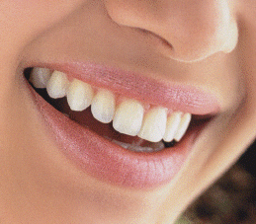
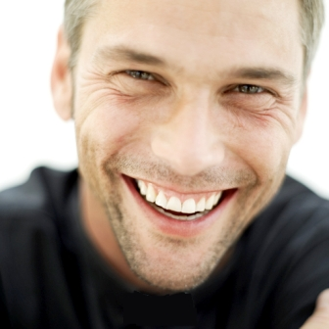
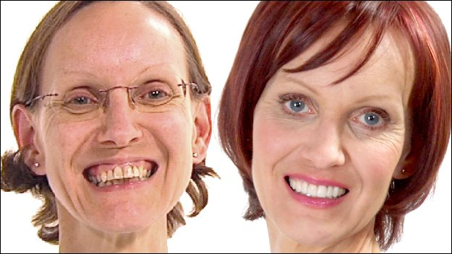
Teeth…

Slide 70
What should you do for healthy teeth?
Notes:
7

Slide 71
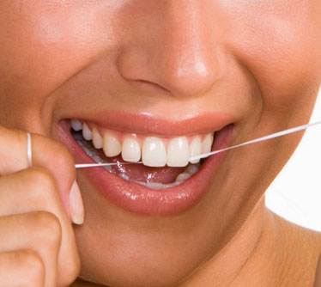





1- Brush your teeth at least twice a day. Half an hour after eating not before.
2- Invest in fixing them. Maybe instead of a vacation?..!
3- Check your teeth after a meal; some food residue might be stuck in between them.
4- Try to keep them white. Whitening toothpaste.
5- Use a breath freshener often.
6- Use dental floss.
7- Smile and show them!!! It might change your day…!

Slide 72




Make-up/Grooming

Slide 73



Make up
NO
YES
NO
YES

Slide 74
Professional light make up
Sun protection
Hydrating cream
Foundation
Mascara
Eye liner (optional)
Blush
Lipstick

Slide 75
GROOMING
Hair must be clean and well styled.
Dandruff should never be ignored.
Excess hair trimmed.
Beards well trimmed.
Use a shampoo that is mild for daily use.
Use conditioners to protect hair.
Care for you skin daily. Sunscreen a must.
Moisturize and scrub.
Shave in the direction of your hair growth. Apply cold water right after shaving to close the pores.

Slide 76
II- THE BODY

Slide 77
Factors that influence which clothing and accessory styles suit you best are..
1- Vertical body type
2- Horizontal body type.
3- Your bone structure.
4-Your weight
5- Your height.
6- Your shoulder angle and width.
7- Your neck length and circumference.
8- Your face shape.
9- Your bust size and posture.
10- Your age.
11- Any problem areas (large/flat bottom or stomach..etc)

Slide 78
Height
(For Women)
Height
(For Men)
under 1.62cm= Short
between 1.62cm and 1.70cm= Average
over 1.70cm = Tall
under 1.72cm= Short
between 1.72cm and 1.80cm= Average
over 1.80cm = Tall
Average Height in Lebanon
Women= 160.8 cm
Men= 174.2 cm

Slide 79
BODY TYPE=
VERTICAL BODY TYPES
HORIZONTAL BODY TYPES

Slide 80


Vertical Body Types:
Long Legs / Short Body
The balanced body
Short Legs / Long Body

Slide 81


Watch the balance and the color proportions

Slide 82

Shoulders width and Horizontal body types

Slide 83





Women
X-Y-A-H-O
X
Y
A
H
O

Slide 84

Men
X-Y-A-H-O
X
Y
A
H
O

Slide 86



Let us take some measurements…

Slide 87

Short Legs?

Slide 88

Long/Short Waist?

Slide 89

For Men
Skinny-Large-Tall-Short

Slide 90
Now that you know your body type, let us learn how to use the 3c’s to look your best personally and professionally:
1- Cut
2- Cloth
3- Color

Slide 91
1- Cut

Slide 92

Tips for Balanced body women
Waistbandless / narrow bands on skirts and pants
Narrow to medium width belts
Dress, skirt and pant waistlines that sit just above or below the natural waistline
Dresses that flow through the waist
High to mid body focal points
Medium-low to high heels
Shoes and sandals that expose a lot of foot

Slide 93
Balanced body for Men
This body is the easiest to dress.
Height, weight, bone structure, age and prominent features will have to be considered.

Slide 94

Tips for Long legs/ short torso women
Low hip and longer over blouses, tops and jackets
Eyes down accessories
Skirts and pants without waistbands
Medium to wide pants and skirts
Narrow non-contrasting belts
Dresses that flow through the waistline
Long-line accessories
Contrast between hemline, legs and shoes
Long shorts and cut-off pants
Low to medium-high heels

Slide 95
Tips for Long legs/ short torso men
Pants are easy to find.
Jackets, T-Shirts, and sweaters that are short enough to their arm lengths are hard to find.

Slide 96



Tips for short Legs/Long Torso women
Eyes-up accessories
Straight skirts
Waistlines just above natural waist
Low contrast between hemline, legs and shoes
Medium to wide belts
Waisted as well as non - waisted dresses
Slim-line, tapered, straight or bootleg
Medium to high heels
Short to medium length dress, pant and shorts
Shoes and sandals that expose a lot of foot

Slide 97
Tips for short Legs/Long Torso men
Men are lucky to have a variation in leg trousers’ length.
Normally sleeves need to be adjusted unless men are tall.
Provided those Men do not have a large stomach, they will look better in shorter style Jackets.

Slide 98




X
A woman with this shape is fortunate, as weight gain or loss is evenly distributed and will often go unnoticed for a long period of time. Clothing is often easy to fit and find.

Slide 99




An X shape appearance can be created by increasing the visual width below the waist using:
A-line skirts,
Bold textures,
Horizontal stripes,
Fuller leg width in trousers.
Minimizing the upper body with:
Open necklines and collars,
Vertical stripes,
Single-breasted jackets,
Garments that are smooth in texture
Garments that drape fluidly over the body.
Y

Slide 100




-To provide the illusion of an X shape figure, width needs to be created in the upper body to balance the lower half. Subtle (non visible) shoulder pads are a slimming accessory (even when not in fashion), especially if her shoulders have a strong slope.
Other slimming strategies include:
-Smooth fabrics below the waistline,
-Darker colors for skirts and pants,
-Slightly tapered or bootleg trousers,
-High placed accessories,
-Medium to high heels.
A

Slide 101




-Shoulder pads,
- Color blocking (to create the illusion of a waist),
-Open single-breasted jackets, vests,
-Soft fabric tops and matching skirts.
H

Slide 102





This shape belongs to full figured women who have a round shape and a low stomach.
A pleasing silhouette is created by:
-Garments and outfits that have a subtle inverted triangle shape, ‘V' necklines,
-Vertical design lines,
-Medium-sized non shiny prints,
-Abstract and geometric patterns
-Medium to dark colors,
-High placed focal points,
-Medium to medium-high heels,
-Below knee-length skirts,
-Hosiery that blends with the shoes and hemline.
O

Slide 103


LARGE
What You Need To Know
-There's a way to dress that flatters every body type, and large body types are no exception.
-Baggy clothing does not hide extra pounds and tight clothing fails to rein it in.
-Proper fit is essential for dressing your body type.
-Single-breasted blazers
-Three-button suit/blazer
-Blazers with a single vent or no vent
-Flat-front pants
-V-neck T-shirts and sweaters
-Dark colors
-Dressy knee-length coat
-Sweaters in thin fabrics
-Dress shoes with a slight heel
-Horizontally-striped shirts
-Dark-rinse relaxed-fit jeans LARGE

Slide 104


SHORT
What You Need To Know
A short body type is defined as a height under 170cm.
Fit is critical; make friends with the tailor.
Dressing in the same color family elongates your body.
-Two-button coats and blazers
-Boot-cut or straight-leg jeans
-Slim ties
-Straight-point collar button-downs
-Narrow belt
-Single-breasted, vent less blazers
-Sleek suits
-Sweaters in thin fabrics
-Shoes and boots with 1cm to 2.5cm heel
SHORT

Slide 105

TALL
What You Need To Know
-Favor straight-leg trousers, two-button blazers and don't forget to have clothes tailored.
-Avoid wearing the same color head to toe - break you body up with color and pattern.
-Double-breasted blazers and jackets
-Turtleneck shirts and sweaters
-Wider ties and belts
-Custom-tailored suit
-Just-below-the-knee coats with belts
-Straight-leg trousers and jeans
-Hip-length two-button blazers
-Thin-soled shoes
TALL

Slide 106


SKINNY
What You Need To Know
-Make friends with EU imports like H&M and Zara.
-Contrary to popular belief, vertical stripes can make you appear larger.
-Fashion trends were designed with your body type in mind - take advantage of it.
- Double Breasted blazers and jackets
-Heavy-knit sweaters
-Crew-neck tees
-Straight-leg or slim boot cut jeans
-Flat-front trousers
-Single or double-button blazers
-Vertically striped dress shirts
-Military-style jackets
SKINNY

Slide 107


Face shape influences the collar’s cut…
NO
YES

Slide 108
2- CLOTH (Fabric)

Slide 109
2- Cloth (Fabric)
(please put the arrow on the right answer)
Dark and Matt
Bright and shiny
Soft fabrics
Thick fabrics
Big patterns
Small patterns
Volume
Slimmer
For big figure
Thinner
For small figure
Few more kilos

Slide 110
2- Cloth (Fabric)
Basic rules
1- Dark and Matt = Thinner
2- Bright and shiny= Volume
3- Soft= Slimmer
4- Thick= Few more kilos
5- Big patterns= For big figure
6- Small patterns= For small figure

Slide 111


Thick fabrics make you look fuller

Slide 112

Thin fabrics make you look slimmer

Slide 113




Large patterns are not for small figures..

Slide 114

Patterns for Men

Slide 115


No large stripes on full men..

Slide 116

For your info…

Slide 117
3- Color

Slide 118


Wearing the Right Colors Will
Make your face come alive
Enrich your face, eyes and hair
Will lift your face, bringing the viewer's eyes to the upper face and away from the body
Visually reduce wrinkles, shadows, blemishes, freckles and facial hair
Minimize double chins, facial disproportion and overweight appearance

Slide 119
What are the 3 factors in choosing the right color palette?
1- Eyes’ Color
2- Hair color
3- Skin color

Slide 120

Wear colors that complement your eyes

Slide 121

Wear colors that complement your hair

Slide 122


Wear colors that complement your skin

Slide 123
Cool/Warm

Slide 124

Cool and warm palette

Slide 125

Cool versus Warm

Slide 126
Determining Colors Factors
Skin Undertones
      Blue (Cool) - Sallow or Olive, Fair to Black
      Yellow (Warm) - Milky, Golden Freckles
Hair
    Cool - Light to Dark Blonde, Light to Dark Brown and Black
    Warm - Light to Dark Golden or Honey Blonde, Light to Dark Warm Brown, Strawberry to Deep Copper Red
Eyes
    Cool - Light to Dark Blue, Hazel, Green or Brown
    Warm - Turquoise to Blue Green, Hazel, Green or Brown

Slide 127



What Colors complement her?
WARM
NO
YES

Slide 128



What Colors complement her?
COOL
YES
NO

Slide 129


Fabric’s material affects the color shade

Slide 130
Train your eye…

Slide 131




Slide 132




Slide 133




Slide 134

Neutrals and colors proportion 3 solids or 2/1

Slide 135

CONTRAST
— High Contrast (bright, dark combinations). Power dressing, often results in others feeling inferior.
— Medium Contrast (light, dark combinations). This is the most people friendly and professional.
— Low Contrast (little or no color difference between garments). This combination is seen as elegant and even at times fashionable, but in business or whenever 'presence' is required it creates a forgettable, boring and ineffectual appearance.

Slide 136




Imagine a color chart of 1 to 10.
Make Black 10, Medium Grey 5 and White 1.
Using this imagery consider anything above a 5 suitable for business and the darker the color the more impact it will have.
The DARKER the color you wear the MORE SERIOUS and professional you will be viewed.

Slide 137

Which one is more credible?

Slide 138



Credibility: Medium Dark to Dark
Likeability: Light colors, textured fabrics and mix of unmatched suits.

Slide 139
III- The business Wardrobe
1- Must have
2- Correct fit

Slide 140
1- Must have

Slide 141


Business Wardrobe for WOMEN
1- Jacket
2- Skirt (preferably lined)
3- 2 to 6 Suits (At least 2 dark color)
4- Blouses (start minimum 4)
5- Sweater (traditional classic)
6- Dress
7- Trouser (2)
8- Accessories (quality pen, scarf , watch and handbag)
9- Coat (winter)
10- Shoes matching lower garments

Slide 142

Business Wardrobe for MEN
1- Jacket
2- Ties (minimum 5)
3- 3 to 6 Suits (At least one in a dark charcoal and on in navy)
4- Shirts (minimum 6)
5- Belts matching shoes
6- Trouser
7- Coat (winter)
8- Shoes matching belts and preferably trousers.
9- Scarves (winter)

Slide 143


Ladies unlimited choice…!!!!

Slide 144


Men too…

Slide 145






Variety depends on how you mix and match your shirts and ties…

Slide 146

Shirts

Slide 147
2- Correct Fit

Slide 148







Good Fit…?
What is wrong in these pictures?

Slide 149





Slide 150
Good Fit
Summary:
1-Waist and neckline: Enough room for 2 fingers
2- Straight waistlines and hemlines Horizontally
3- Able to lift arms.
4- No clinging or horizontal lines forming.
6- Length to top of shoes.
7- When sitting , skirts should not be too short.
8- Ties’ length reaches top of the belt.

Slide 151


Slide 152



Slide 153
IV- The Accessories

Slide 154
Accessories are:
A- Ties/Scarves
B- Handbags
C- Shoes and socks
D- Make-up/Grooming
E- Belts
F- Necklaces and others
Notes:
6

Slide 155

A- Ties/Scarves

Slide 156

What a wide choice!!!!!

Slide 157





Slide 158






Slide 159


Slide 160


Slide 161



B- Handbags and suitcases
Invest in one quality leather handbag

Slide 162





C- Shoes and socks
Appropriate style for position
Neutral color that coordinates with hemline
Avoid too high or too narrow heels (ladies)
Heels kept in excellent condition
Polished and in good repair
a spare pair of pantyhose always ready

Slide 163

E- Belts
Invest in a quality leather belt.
Be discrete with the brand.

Slide 164


F- Necklaces and others

Slide 165
V- The Hygiene
1- Bad breath
2- Underarms smell
3- Perfume
4- Nails

Slide 166




Bad breath

Slide 167





Underarms bad smell

Slide 168


Perfume

Slide 169



Nails

Slide 170
Posture and Body Language

Slide 171

Alignment
The Alexander Technique

Slide 172


Slide 173


Slide 174


Seated alignment

Slide 175


Legs

Slide 176



Standing

Slide 177


WALK: Move with a mission!

Slide 178

PERSONAL SPACE
Respect personal space and stay at one arm distance.

Slide 179
II- MASTER YOUR BEHAVIOR

Slide 180
Frank Outlaw once said…
Watch your thoughts; they become words.
Watch your words; they become actions.
Watch your actions; they become habits.
Watch your habits; they become character.
Watch your character; it becomes your destiny.

Slide 181
Actions and attitudes

Slide 182

SMILE !!!!!!!

Slide 183
The easiest and most difficult action and attitude…
Smile while greeting
Smile while answering the phone
Smile while introducing yourself
Smile while offering a drink, coffee or chocolate…
Smile while helping
Smile while giving a message
…
It is worth every single effort!!!

Slide 184
Greeting and Receiving
Cordial, Professional and Friendly:
“ Good afternoon Mr. Najjar...”
“ How are you Mr. Najjar?”
“ Would you like something to drink?”
“ Welcome Sir, How may I help you?”
“ Sorry I can’t disturb Mr. Diab right now. May I help you? May I take the info? May we call you ?”

Slide 185

Handshakes

Slide 186






Handshakes talk…

Slide 187

Most important!

Slide 188

Proper Introductions

Slide 189
Introduce the “less important” person to the “most important” person:
(Mention the name of the higher status person first)
Mr. Haddad, I’d like to present my daughter Mona.
Mona, this is Mr. Kamal Haddad, the president of our company.
Notes:
Use last names unless invited other wise

Slide 190

Exchanging Business Cards
Notes:
Never with your left hand!!!!!!

Slide 191


Slide 192

Never!!!!!!
NO
NO
NO

Slide 193


You are your business card!
=

Slide 194


Slide 195


Escorting
Guests should always be escorted in and out.

Slide 196

Voice
Speak clearly.
Live your words.
Articulate and pronounce your words well.
Show confidence by lowering your tone.
Pause a moment before important points.
Rely on vocal variety by changing your tone and voice level.

Slide 197


Phone Etiquette
APAVE Good morning,
Lama speaking…
Hello!

Slide 198
Phone Etiquette
1- Always answer with a smile.
2-Answer within 3 rings.
3- State the company’s name.
4- Greet with good morning, good afternoon or good evening.
5- State your name.
6- Never address a caller as well as employees by his or her first name.
7- Ask if you may take a message if the person needed is away from his or her desk.
8- Take specific detailed message on paper.
9- Have a brief summary before you hang up.
10- For transfers…Listen to what or who the caller needs and then ask if you may transfer him or her to the proper person that could help.
11- Never transfer a call without informing the person you are transferring to that he or she has a phone call and if possible giving them the name and reason to the call.
12- Always finish the call with a thank you.
13- Never hang up before the caller hangs up.

Slide 199

Answering Machine…
Hello, You have reached BF Holdings. Sorry we are closed. Our opening hours are Monday through Friday from 9am to 6pm. If you would like to leave a message after the beep we would be able (or glad or happy) to call you back on Monday. Thank you!

Slide 200

Gestures, Facial expressions and nervous habits
1- Clearing throat
2- Sniffing nose
3-Holding hands in front of face
4- Touching hair constantly
5- Making noise with a pen or pencil

Slide 201
Business Meeting

Slide 202
Be Prepared

Slide 203

Review, research and make a list of questions, comments and ideas BEFORE any meeting… (always have your right- hand free and ready for handshakes)

Slide 204

Punctuality
How and what if??
Notes:
Plan when to leave for the meeting rather than when to arrive. On time for office one on one mtg. wait to enter when late.

Slide 205

Write down when to leave…

Slide 206



Actions for being late…

Slide 207
During a Meeting

Slide 208






Participating
TO DO:
NOT TO DO:

Slide 209


Being Positive

Slide 210

Team work
Notes:
Drawing added lines on one paper…

Slide 211

Being Productive
Notes:
Think outside of the box

Slide 212
One single line to make “6”
IX

Slide 213




Being Polite
DO NOT LIST!!
Notes:
Entering and exiting

Slide 214


Excellent Listener

Slide 215

Discretion

Slide 216

Being Proactive

Slide 217
How many “f"s are in this paragraph?
Often in his life, Jeff reflected on one of the persons whose life he affected most. Without a doubt, it was his golf student Frank. Frank was one of those few kids who experienced both the thrill of victory and the agony of defeat. If Jeff took just one day off from work, Frank typically called to ask if anything happened. Indeed, Jeff and Frank were inseparable.

Slide 218
Good Results = Work + Details
Often in his life, Jeff reflected on one of the persons whose life he affected most. Without a doubt, it was his golf student Frank. Frank was one of those few kids who experienced both the thrill of victory and the agony of defeat. If Jeff took just one day off from work, Frank typically called to ask if anything happened. Indeed, Jeff and Frank were inseparable.
Result: 28

Slide 219

Handling the Unexpected
Coughing
NO!

Slide 220

Sneezing
NO!

Slide 221


Taking Medicine
NO!

Slide 222

Meeting people with handicap…
Let them lead the move…

Slide 223

Using the Restrooms
OUPS…

Slide 224



Acknowledge your mistakes, correct them, learn from them, forgive yourself and move on.

Slide 225

Business Dining

Slide 226





Did you know…?

Slide 227

Follow up

Slide 228

Thank you notes…

Slide 229

Keeping in touch

Slide 230



Refined manners:
We are Ladies and Gentlemen working with Ladies and Gentlemen.

Slide 231

Action and attitude check up list

Slide 232
III- MASTER YOUR ENVIRONMENT

Slide 233
What you should not have or do…
Smoke or have any cigarette buts in your office.
Have a very messy desk.
Have a dirty desk.
Have an unorganized desk.
Have too many family photographs or children artwork.
Have non work related magazines.
Eat at your desk.
Inappropriate posters.
Religious materials.
Leave an unclean shared kitchen.
Have an unclean car
Notes:
10

Slide 234







What you should do…

Slide 235

THANK YOU!

